Slide 1
Puberty!! Know the bare facts

Slide 2
What is puberty??
Our bodies grow and change all the way through our lives.
Puberty generally begins somewhere between the ages of nine and fifteen in girls and eleven and sixteen in boys, but everyone is different.

Slide 3
Changes that happen to both boys and girls
Both become taller and heavier, but usually boys will grow taller.
Hair grows under arms
Pubic hair grows around the genitals
Your sweat glands begin to work and you will produce body odour
Your skin and hair will become more oily and you may get some spots, or even acne

Slide 4
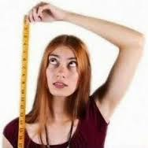
Growing
You’ll get taller and this might happen quite quickly
Average growth in girls is about 3.5 inches a year

Slide 5
Weight gain
You may notice that you put on a bit of weight and this is a normal part of puberty
Without gaining this weight you will not be able to grow taller, develop breasts or get your first period.

Slide 6
Breast development
Breast and hips get bigger
Your breast and hips get bigger. You might feel itchy or uncomfortable when this happens. This is normal.

Slide 7
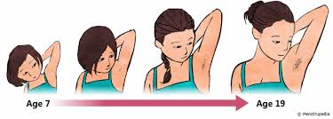
Hair growth
Hair grows under your arms and around your vagina. Some girls develop hair in other parts of their body, such as their top lip. This is normal.

Slide 8
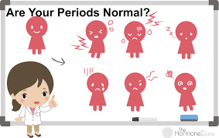
Periods
Periods start
Your periods will start at some point during puberty. You might start experiencing period pains before or during your period.
Vaginal discharge
You may notice that your vagina produces vaginal fluid (discharge). This is normal. It’s your vagina’s way of keeping clean and healthy. The discharge should be colourless or white and shouldn't smell. If it looks green or yellow and smells, see a doctor because it may be an infection such as thrush (this is very common and easily treated)

Slide 9
Sanitary
products

Slide 10
Pads
Pads, towels and sanitary products.
It is important to change the sanitary towel every 3-4 hours.

Slide 11
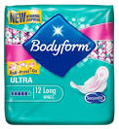
Different brands
The tear drop shows the absorbency of the pad

Slide 12
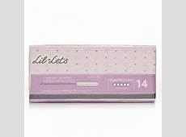
Tampons
Remember to change your tampon every 3- 4 hours and avoid wearing them overnight, use a pad instead.

Slide 13
Correct disposal

Slide 14
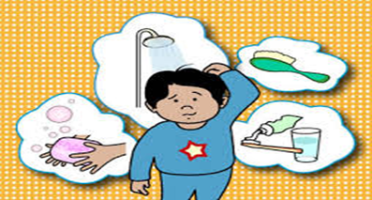
Keep your bits clean !!!
Hair – Wash your hair at least once a week. Hair can become dirty and greasy quickly.
Face – You may get spots. This is because your skin becomes oily, wash you face everyday.
Teeth – you must brush your teeth twice daily. Look after them by limiting the amount of sugary foods and drink.
Under arms – As you grow under arm hair will appear and this area can become hot and sweaty. Sometimes this can cause BO (Body Odour) so it is important to keep this area clean. You can use deodorant or antiperspirant

Slide 15
Keep your bits clean!!
Genital areas – It is important to shower or wash this area daily. Change your underwear on a daily basis aswell.
Feet – Your feet work hard and become hot and sweaty!! It is important to wash them everyday and dry in-between your toes to prevent infections like ‘athlete’s foot’.
Hands – Washing your hands is very important as many germs are lurking there. Washing your hands after using the toilet, after coughing or sneezing and before eating food.

Slide 16
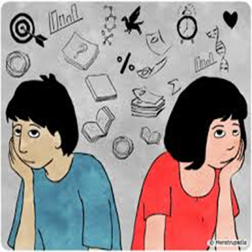
Emotional Changes
You may feel moody at times and experience mood swings. Being happy to sad or angry to anxious.
You may worry about your looks and compare yourself to your friends. You may also worry about what others think of you.
You may feel embarrassed about getting changed in front of others
You may start feeling attracted towards other people
You may also want to gain independence from your parents

Slide 17
Any questions?

