Slide 1


Puberty
Know the bare facts

Slide 2

What is Puberty?
Our bodies grow and change all the way through our lives.
Puberty generally begins somewhere between the ages of nine and fifteen in girls and eleven and sixteen in boys, but everyone is different.
Notes:
Ask the class what puberty means to them

Slide 3

Changes that happen to both boys and girls.
Both become taller and heavier, but usually boys will grow taller.
Hair grows under arms
Pubic hair grows around the genitals
Your sweat glands begin to work and you will produce body odour
Your skin and hair will become more oily and you may get some spots, or even acne

Slide 4
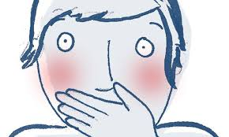
Changes in boys
The larynx (voice box) gets bigger. The voice breaks and gets deeper in tone.

Slide 5
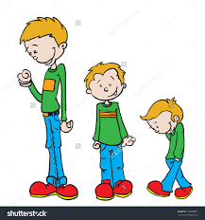
Changes in boys
You will grow taller. You will grow approximately 5-12cm a year!!

Slide 6
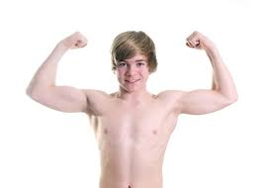
Changes in boys
Your body shape will change. Your muscles will get bigger.
And your shoulders will get broader

Slide 7
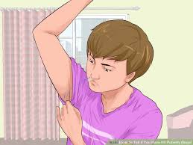
Changes in boys
Your penis and testes will grow bigger and you will grow pubic hair (around your penis)
Your testes start to produce sperm cells
You will grow hair all over your body!!

Slide 8
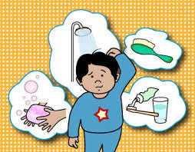
Keep your bits clean!!!
Hair – Wash your hair at least once a week. Hair can become dirty and greasy quickly.
Face – You may get spots. This is because your skin becomes oily, wash you face everyday.
Teeth – you must brush your teeth twice daily. Look after them by limiting the amount of sugary foods and drink.
Under arms – As you grow under arm hair will appear and this area can become hot and sweaty. Sometimes this can cause BO (Body Odour) so it is important to keep this area clean. You can use deodorant or antiperspirant

Slide 9
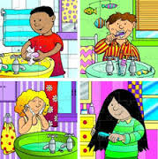
Keep your bits clean!!
Genital areas – It is important to shower or wash this area daily. Change your underwear on a daily basis as well.
Feet – Your feet work hard and become hot and sweaty!! It is important to wash them everyday and dry in-between your toes to prevent infections like ‘athlete’s foot’.
Hands – Washing your hands is very important as many germs are lurking there. Washing your hands after using the toilet, after coughing or sneezing and before eating food.

Slide 10
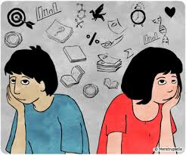
Emotional Changes
You may feel moody at times and experience mood swings. Being happy to sad or angry to anxious.
You may worry about your looks and compare yourself to your friends. You may also worry about what others think of you.
You may feel embarrassed about getting changed in front of others
You may start feeling attracted towards other people
You may also want to gain independence from your parents

Slide 11

Any Questions?

