Slide 1

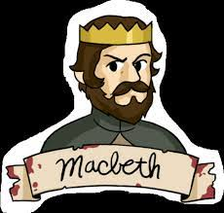
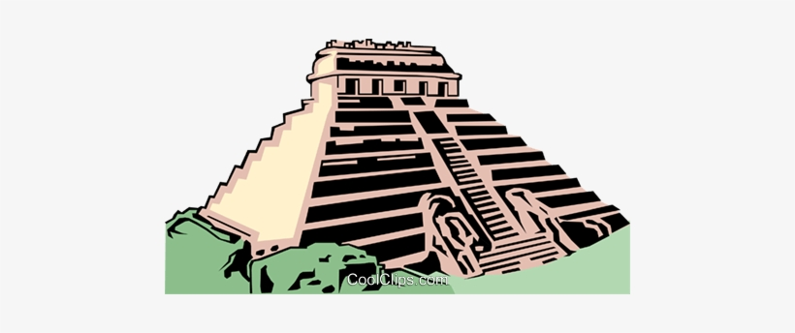
Learning Map for Year 6: Spring 2025 Macbeth and the Maya
Home learning usually set on Monday for Wednesday, Wednesday for Friday and Friday for Tuesday.
Data And Information Introduction
Spring 2
Hockey and Handball
Texts – Macbeth, The Teacher Pleaser and The Giant’s Necklace
These texts will be used to inspire writing. The children will write for a range of purposes/audiences including:
Descriptive writing
Non-Chronological Report
Retelling
Playscripts
Narratives
Monologues/Soliloquys.
Letters
Poetry
Characters Analysis
Programming Variables in a Game
Please
encourage
your child to read
each day
ICT
Spring 1
Dance and Dodgeball
History & Geography
Science
PE
History: Ancient Mayan Civilisation
Mayan Ruins, Mayan Artefacts, Mayan City States, Mayan Gods and Religion
Mayan Daily Life, Mayan Writing, End of Mayan Civilisation.
Geography: Ancient Maya and North America
Where did the Mayans live? Exploring Mesoamerica, Modern Maya, Location and Countries of South America, Climate in South America, Mountain Ranges of South America, Human Geography of South America, Trade and Industry in South America, In-Depth study of a South American country and comparisons with the UK.
Animals Including Humans
Describe the ways in which nutrients and water are transported within animals, including humans. Identify the main parts of the human circulatory system and describe the functions of the heart, blood vessels and blood. Recognise the impact of diet, exercise, drugs and lifestyle on the way their body’s function.
Living Things and their Habitats.
Describe how living things are classified into broad groups according to common observable characteristics and based on similarities and differences, including micro-organisms, plants and animals. Give reasons for classifying plants and animals based on specific characteristics.
English
Year 6
Macbeth and the Maya.
RE
PSHE
Religious Education
Sources
Learning about a wide range of books and knowing their purpose. The Bible is the story of God’s love for us, told by the People of God.
Unity
Learning about what nourishes and what spoils friendship and unity. We will learn that the Eucharist challenges and enables us to live and grow in communion everyday.
Death and New Life
Using scripture to understand loss and death bring about change for people but ultimately it leads to new life.
Art and DT
Maths
Statistics
Music
Art
Mayan Stelae of the Mexican Landscape
DT
Mayan Food
Ratio
Thrive Creating strategies for resilience and problem-solving.
We are learning about djembe drums and Gestures, exploring leading a group of musicians playing djembe using hand signs to sculpt the sound.
Fractions, Decimals and Percentages
Algebra
Area, Perimeter and Volume.
Writing simple phrases in French with increasing confidence and learning the grammar and vocabulary related to food chains and zoo animals. Discovering and discussing the world of ‘Francophonie’.
ENRICHMENT
French

