Slide 1
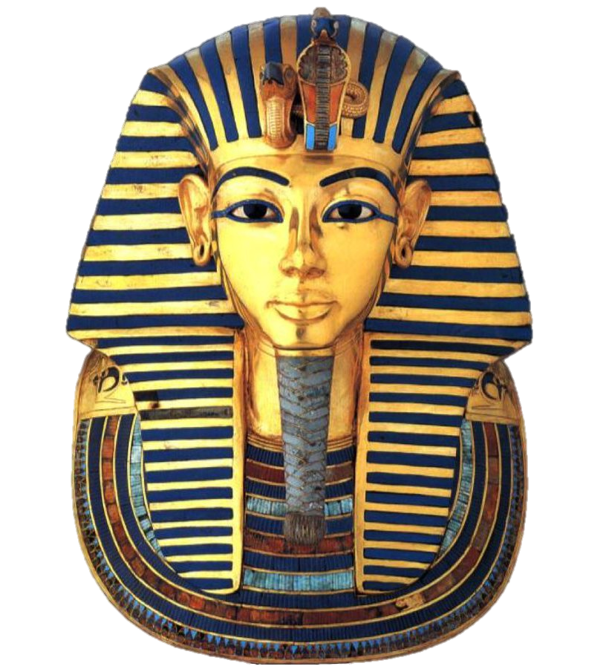
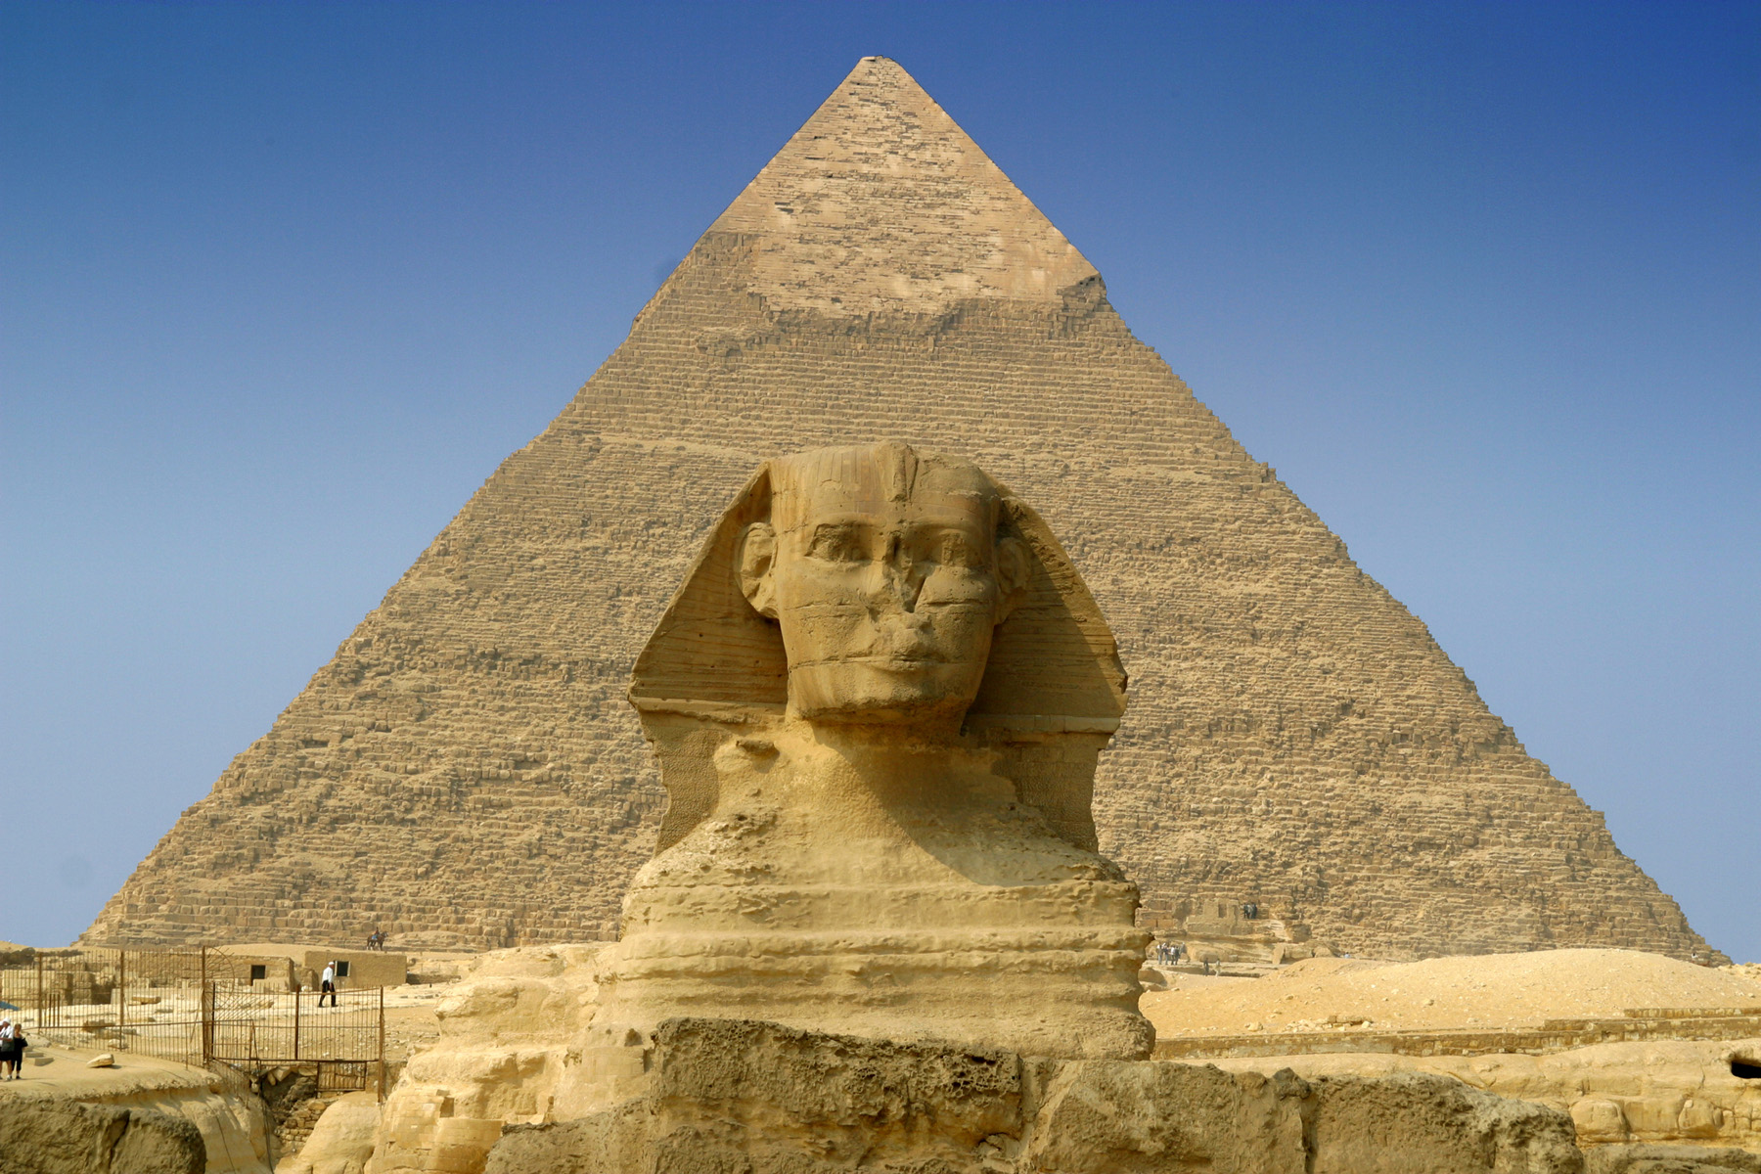
Curriculum Map for Year 3: Spring 2025
Along the River Nile!
Please
encourage
your child to read
each day
Sequencing Sounds
Spring 1 – Dance + Football
The books ‘Marcy and the Riddle of the Sphinx’ and ‘The Ice Palace’ will be used to inspire writing. The children will write for a range of purposes/audiences including:
Descriptive writing
Non-Chronological Report
Retelling
Newspaper articles
Narratives
Letters
Online Research
Home learning set on Friday and due back the following Tuesday
Spring 2 – Fitness + Yoga
PE
ICT
English
History
Forces and Magnets
Pushes and Pulls – Faster and slower – Friction – Magnets
Ancient Egypt
River Nile - Pyramids - Pharaoh’s and God’s - Mummification – Hieroglyphics – Tutankhamun and his Tomb – Cleopatra
Year 3
Along the River Nile!
Science
Animals Including Humans
Nutrition – Food Labels
- Animal Skeletons – Human Skeletons - Muscles
Geography
Art and DT
Rivers and the Water Cycle
- Parts of a River – Famous Rivers – The Water Cycle and it’s importance – Water Pollution
Multiplication and Division
Maths
RE
PSHE
Length and Perimeter
‘Come and See' Scheme of Work
Family: Learning about The Family of God in Scripture - Jesus has a natural family with real people with names and a history.
Belonging: Through Baptism and Confirmation people are given the gift of the Holy Spirit and are called to respond in their lives.
Loving: God’s gift of Jesus is a gift of love to all people of all time
Egyptian Collars (Textiles)
Eating Seasonally
(Food/Nutrition)
French
Fractions
Thrive
Understanding ourselves.
Creating strategies for resilience and working together.
Music
Expanding our number knowledge and ask and give out our age.
French playground games applying our number and colour knowledge, and learning new game vocabulary.
In a French classroom: follow simple instructions, play school bag detective and learn about masculine and feminine words.
Singing songs and musical games. We are using these to learn about crotchet/quaver and crotchet rest, and reading, improvising and composing with these rhythm elements.
Mass and Capacity

