Slide 1

Meet the teacher September 2025
Year 4

Slide 2

Who is Who?
Mrs Furrer – Class Teacher (Monday – Thursday)
Miss Wilding - Class Teacher (Friday)
Miss James– Teaching Assistant (Monday – Wednesday mornings)
Mrs Saratowicz – Teaching Assistant (Monday – Wednesday afternoons)
Mrs Coney – Teaching Assistant (Thursday - Friday)

Slide 3

Start of the Day
Children are expected to be in school between 8:45am and 8:55am.
No cycling or scootering in the playground at this time.
Year 4 need to enter the building via the side door as they enter through the gate.
Parents/carers should leave the playground once their child is in school.
If you are late, please ensure your child comes into school via the Main Office. They will be signed into the late book.
If your child is absent, please contact the school and inform us. An indication of your child’s symptoms would be beneficial so that we can support you and your child.

Slide 4

End of the Day
Children should be collected at 3:20pm from the Side Gate by the Prayer Garden.
Please arrive and exit the playground promptly through the main school gate.
If for any reason you are late, please notify the Main Office. Late collections will be registered in the late book.
Please inform us if your child is being collected by someone else by phoning the school office or via email.
No cycling or scootering at these times.

Slide 5
Uniform
All school uniform and kit should be clearly named.
Every Tuesday and Thursday, pupils should come to school wearing their PE kit.
Indoor PE kit: Sacred Heart maroon t-shirt, navy blue school shorts or skort, white socks and trainers.
Outdoor PE kit: Sacred Heart tracksuit jumper and bottoms, white socks and trainers.
Children should not be wearing jewellery .
Hair tied back for school at all times.
Ties are expected to be worn with winter uniform.
Winter uniform after half-term until after the Easter holiday.

Slide 6
Equipment
Children should bring their Reading Journal, reading book and Spelling Journal to school every day.
Every child should have a named water bottle (and a packed lunch if they have one).
Children can bring a piece of fruit or vegetable for break time. No nuts.
Your child will need to bring in a coat as the weather becomes cooler.
KS2 are encouraged to bring in small pencil case with their own equipment and a mini dictionary and thesaurus (Christmas present!)

Slide 7
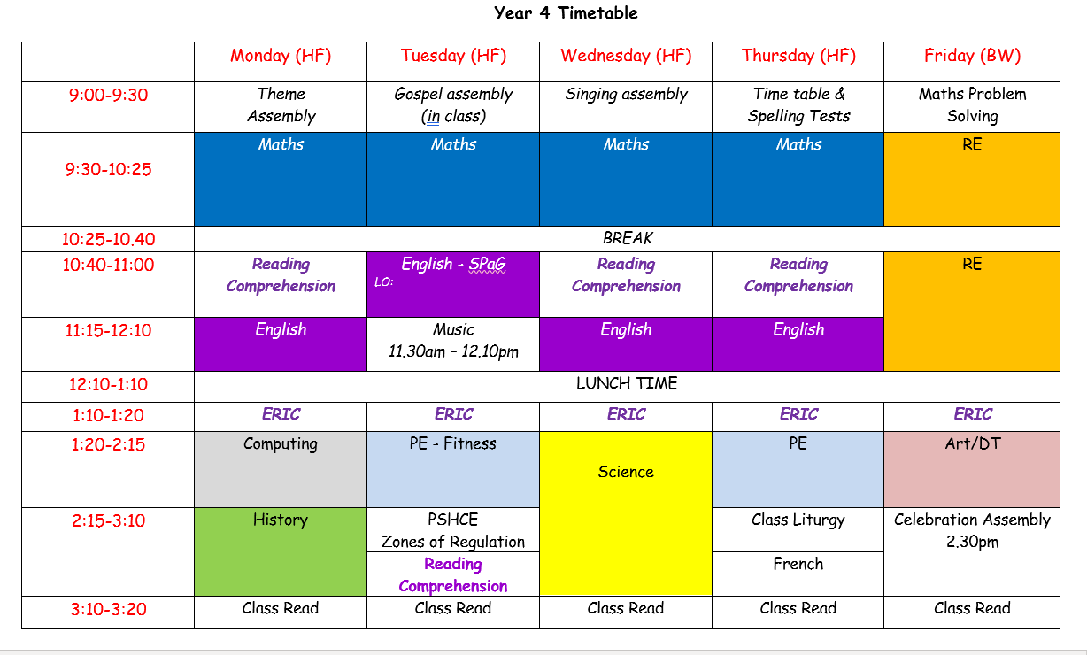
Daily Routine

Slide 8
Behaviour
Rewards
Consequences*
Stickers
Happy Face and Ticks
Marbles
Star of the Week
Good Manners
Headteacher Award
Wow Cards
Timeout
Reflection Face
Reflection activity (Restorative Approach)
Discussion with another teacher
Discussion with the headteacher\deputy headteacher
* Please note that while in some instances the consequences escalate as written – this may not always be the case.

Slide 9
Home Learning: English
One piece of English Home Learning a week:
Reading comprehension.
SPaG consolidation.
Spellings: weekly list of words to learn with related activities to help practise the pattern.
Reading:
20 minutes each day recorded in their Reading Record.
5 entries in Reading Journal per week and summarise 2 of them.
Read aloud to an adult twice a week if a free reader.
Daily if on the reading scheme.

Slide 10
Home Learning: Maths
One piece of Maths Home Learning a week linked to class content.
Some tasks may be computer-based using an online platform like Mathletics.
Daily Times Table Tests

Slide 11
Home Learning
Weekly home learning tasks will focus on consolidation.
Home learning will be set on a Friday and should be handed in by:
Reading Journals: Friday
SPaG/Comprehension/Maths: Tuesday
Spelling Journals: Monday
Children will receive English and Maths home learning every week.
They may get half termly home learning linked to RE and half-termly home learning linked to History or Geography and Science.

Slide 12
Curriculum
English:
Reading and comprehension skills.
Grammar, Spelling and Punctuation ‘Non-negotiables’.
Class Text this term:
The Adventures of Odysseus.
Aesops’ Fables
Poetry
Mathematics:
White Rose curriculum.
Curriculum newsletter issued every term.
A weekly email will be sent out every Friday:
Any changes to school routines and events will be communicated via email.

Slide 13

Feedback Expectations
Verbal feedback is a priority.
Written feedback will be given as follows:
Consistent use the codes detailed on our school marking policy.
Children will have one focused mark in RE, Science and Learning Themes per topic.
Children will receive Next Steps in Maths, once a week.
Opportunities for Self and Peer Assessment will be introduced in activities that lend themselves to the process.

Slide 14
Key Dates
Friday 26th September – Macmillan Coffee Morning
Monday 3rd November – Year 4 swimming lessons begin (6 weeks)
Friday 19th December - TERM ENDS (1.30pm finish)

Slide 15

TBA

Slide 16
Our Mission
“Our mission is to create a harmonious community, where each one of us is a valued member who can ‘grow in love’, guided by the teaching of the Catholic Church.”

Slide 17
Our Vision
We work to fulfil the vision that each Sacred Heart pupil will:
Demonstrate our school values and be active contributors at school, home and in the wider society.
Value and develop their unique talents and gifts to reach their full academic and spiritual potential.
Be effective communicators.
Be aspirational for themselves and their peers.
Develop their skills, knowledge and understanding to thrive as lifelong learners.

Slide 18
Our Values
Values work continues each year– delivered via assemblies, lessons, the way we operate in class and the way we respond daily to situations.
Achievement
Care
Consideration
Generosity
Love
Mutual Respect
Patience
Prayer
Tolerance

Slide 19
We work on these things at school not just the academic…
Behaviour
& Attitudes
Attitudes to learning
Behaviour
Attendance and punctuality
Personal
Development
Enrichment
British, School and Gospel values
Health and wellbeing
Citizenship
Equality and diversity
Preparation for next steps – socially ready
Quality of
Education
Curriculum design, coverage and appropriateness
Curriculum delivery - expert teaching ensuring progress, knowledge and skill development for all
Pupils ready for next stage of educational journey
Pupils’ spiritual and emotional wellbeing is underpinned by our RE curriculum, Collective Worship and Catholic Social Teaching

Slide 20

There is a reason for every behaviour…
The Thrive Curriculum – continues all the way through school

Slide 21

The Zones of Regulation Curriculum – continues

Slide 22

Restorative practice in school

Slide 23
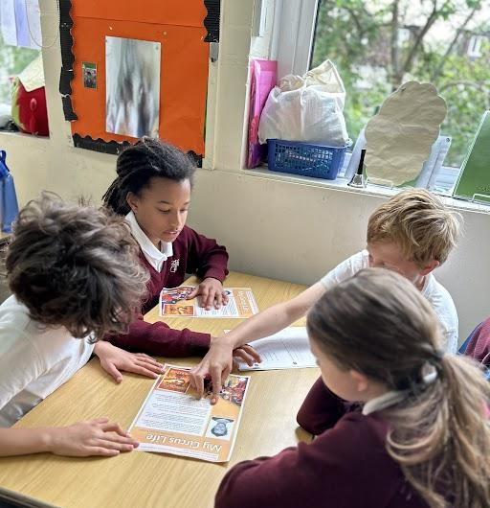
The importance of reading
A love of reading is the best indicator of future academic success.

Slide 24
Why is reading crucial for young minds?
Important: Please read with your child all the way through primary school.
Continue to read aloud together even after they are a ‘free reader’ as this develops and maintains fluency.
Reading is key to everything in a child’s education.
1. It improves vocabulary
2. Boosts self-esteem – read often - speak and write with confidence
3. Improved concentration and memory
4. Enhances creativity
5. Builds critical thinking skills

Slide 25
Absence, Attendance and Punctuality
Absence is only authorised in exceptional circumstances. Please read the new Attendance Policy as new government guidelines are now effective.
Regular school attendance is an essential important part of giving your child the best possible start in life.
The school cannot authorise absences for holidays and all such requests will be unauthorised. In addition, any absence from school for holiday for longer than a period of 5 school days will be automatically referred to the Education Welfare Officer for follow up.
Please write to Mrs Green, Headteacher, if you require time off school at least two weeks in advance. A written response either email/letter will be sent back informing you of any decisions regarding the requests for absences.
Fines
Under new national rules, all schools are required to consider a fine when a child has missed 10 or more sessions (5 days) for unauthorised reasons. Note these absences do not have to be consecutive.
The school expects attendance of at least 95%. Children already have 175 days of each year not in school.
They are expected to attend 190 unless they are sick or there are exceptional circumstances.
Punctuality – children must arrive by 8.55 am. Helping your child learn punctuality at an early age builds good habits for school and life. Being on time supports their learning, confidence and respect for others who are waiting on them.

Slide 26


Slide 27


Slide 28
The importance of a good home and school partnership - for reference.
Enhances the educational experience for the children and supports their overall development.
Key advantages
1. Enhanced Academic Performance: Improved academic results through consistent educational support.
2. Improved Behaviour and Attendance: Better behaviour and attendance from early issue resolution.
3. Stronger Parent-Teacher Relationships: Mutual respect and understanding between parents and teachers.
4. Personalised Learning: Tailored teaching strategies based on a deeper understanding of each child.
5. Increased Parental Engagement: Greater parental involvement in school activities and decision-making.
6. Better Social and Emotional Development: Supportive environments for emotional and social well-being.
7. Consistency in Values and Expectations: Consistent messages about education, behaviour, and effort.
8. Resource Sharing: Exchange of resources and strategies to support learning.
9. Enhanced Community Ties: Stronger sense of community among families and the school.
10. Early Identification of Issues: Timely support for academic, social, or emotional challenges.

Slide 29

Talk to Us!
Please do not hesitate to contact us:
If you are worried about any aspect of your child’s learning, well-being or experience at school.
If you have questions or need clarification about school routines or home learning details we will try to respond to emails received within 48 hrs.
hfurrer@sacredheart.richmond.sch.uk
If your concern is urgent, please notify the office.

Slide 30
THANK YOU for such a positive start to the year!
Your support and positivity means a lot to Sacred Heart.
Any Questions?

